Slide 1
PROGRAM TO FLOWCHART CONVERTER
DONE BY
SHARVESH R
RAGAVENDAR K
PURUSHOTHAMAN M

Slide 2
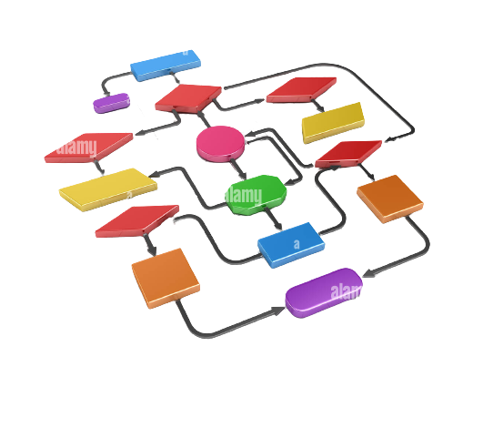
PROBLEM STATEMENT
The project converts the given python program code into a flowchart

Slide 3

OBJECTIVES
To convert given python program code into a flowchart.
To increase concept clarity towards given problem to user.
To reduce time complexity involved in figuring out errors in code by human.
To better understand the flow of code.

Slide 4
EXISTING SYSTEM
The pre-existing system allows the user to convert an intermediate instruction(algorithm) in python into a flowchart.js DSL(domain specific language).
Flowchart.js.org is the online service widely used to do so.
The existing system is not user-friendly and needs an active internet connection to convert the algorithm into a flowchart.
The user cannot just simply enter a code and get a flowchart as an output on this site, it needs a specified intermediate code(custom keywords) assigned by its developers.
It functions like a demo version and lacks various key features.

Slide 5
PROPOSED SYSTEM
The proposed system is much more user-friendly and can work without an active internet connection.
The software can be installed into the user’s device so it provides quick access and hassle-free handling to the user.
The proposed system can also convert a compilable python code into a flowchart in addition to converting the intermediary instruction (algorithm) into the same.
It has an improved GUI and thus is more visually appealing to the user.

Slide 6
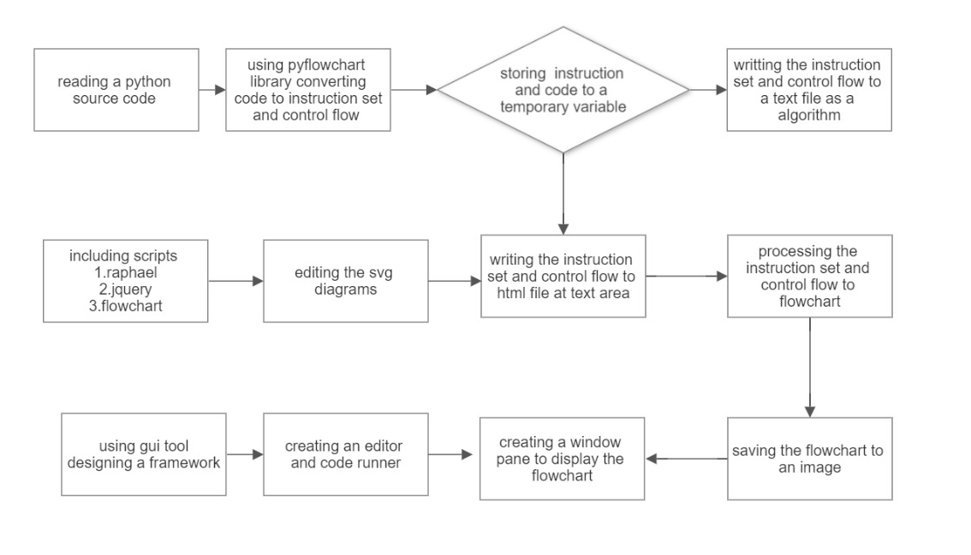
SYSTEM ARCHITECTURE

Slide 7
SYSTEM ARCHITECTURE
The user gets the input file which is read by the software
The pyflowchart library is to be installed using 'pip'.
Pyflowchart is a package to: generate instructions for the python source code which in order supports “flowchart.js”.
The pyflowchart accessed the python program and it converts the code into intermediate instruction.

Slide 8
SYSTEM ARCHITECTURE
The intermediate instruction is like an algorithm for 'flowchart.Js'.
Then the instruction is copied and pasted into html
The HTML javascript file uses script source jquery, rapahel, and flowchart will process the intermediate instruction to SVG flowchart
Jquery is a lightweight, "write less, do more", javascript library.

Slide 9
SYSTEM ARCHITECTURE
Rapahel.Js is a javascript library designed specifically for artists and graphic designers. It is the brush you can use to apply images directly to the browser's canvas.
The purpose of jquery is to make it much easier to use javascript on your website
Scalable vector graphics (SVG) are an xml-based markup language for describing two-dimensional based vector graphics.

Slide 10
SYSTEM ARCHITECTURE
Using file handling the instruction is feed to the text area of the html file
Qt is used for developing graphical user interfaces (gui’s) and multi-platform applications that run on all major desktop platforms and most mobile or embedded platforms
QT GUI is a graphical unit interface framework which provides editor and displaying the flowchart to the application window.

Slide 11



SYSTEM ARCHITECTURE
Languages used : Python
JavaScript
HTML

Slide 12
BENEFITS
Quickly converts a given problem statement or piece of code or algorithm into a flowchart.
Helps the user visualize the question, which helps in better understanding of the problem.
Provides conceptual clarity by being a supplement to the pre-existing code or algorithm or program statement.
Shows the flow of control in a code in a user-friendly way regardless of prior knowledge of programming language(s).

Slide 13
BENEFITS
Helps in documenting the process of code writing.
Useful in planning the coding of a problem statement before code-writing to reduce the time involved in writing code.
Acts as a blueprint or backbone structure during program designing.
Helps grasp the right logic of the problem statement, which may otherwise lead to a major loss of time and manpower.

Slide 14
BENEFITS
Paves way for improvement of code as it is in the form of visually easier-to-grasp diagrams.
Efficient communication with a client or a third party who has no prior knowledge of the coding.
Distinctly showcases the steps and the number of steps involved in solving the problem.
Easier detection of errors as a result of clear division of flow of control in the form of diagram and hence easier error correction.

Slide 15
THANK YOU

